Slide 1

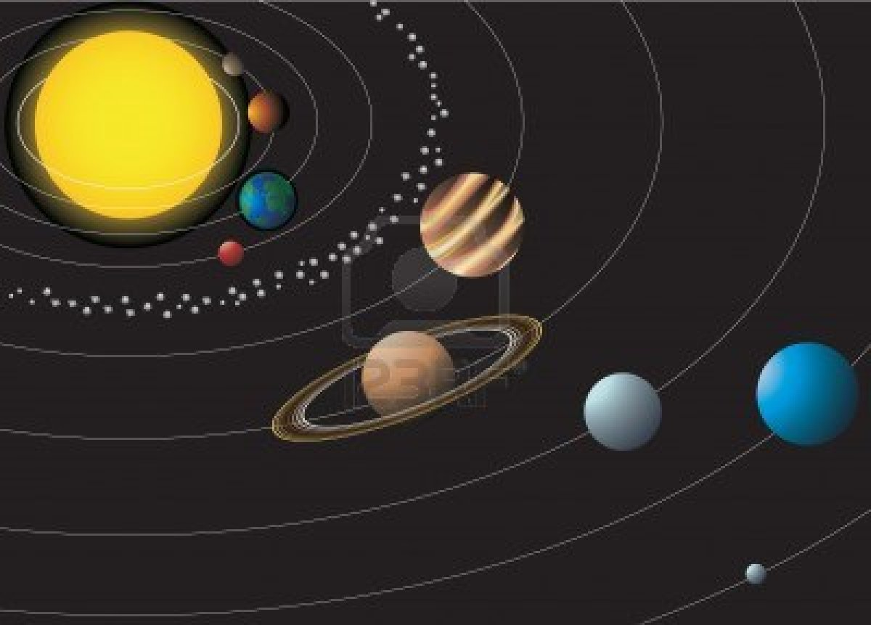
Welcome every body

Slide 2


Presented by:
Utpal dey
Assistant Teacher.
Borhangong Govt. Primary School. Borhanuddin, Bhola.

Slide 3
Lesson Introduction
Subject :English : Class : three Unit :six lesson :one Title : people and occupation
Time :forty munities

Slide 4

Learning outcomes
Students will be able- to listen attentively to say new words(farmer, policeman, blacksmith and doctor)with correct pronunciation.
to talk about the people And their objects.

Slide 5


Creating emotion (By singing a song)
(We are the man -------------We are the tailor.)

Slide 6
Presentation
Time : 20 minutes
Showing picture:

Slide 7
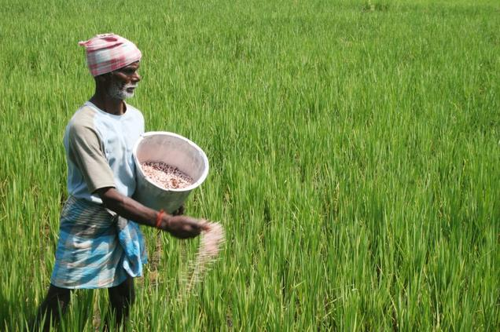
What you are looking in the picture?
A Farmer

Slide 8
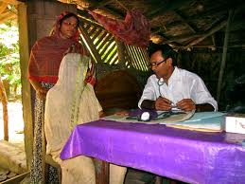
A Doctor

Slide 9
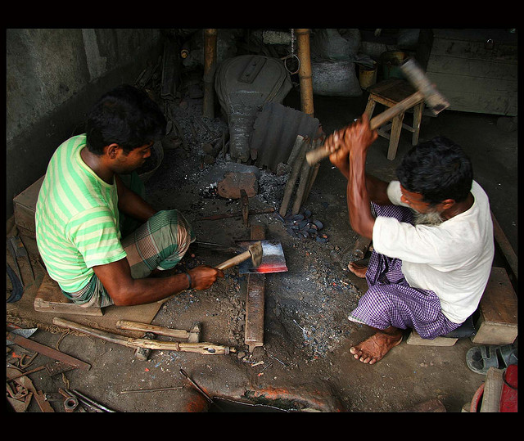
Blacksmith

Slide 10
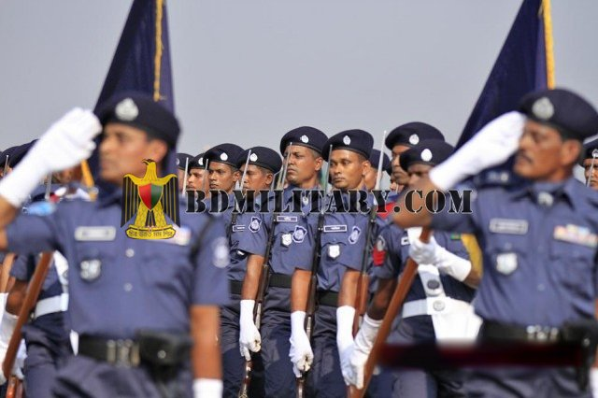
Police man

Slide 11
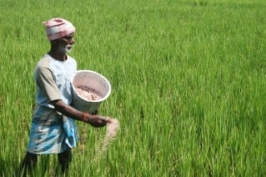


Finding New words : (Farmer, Doctor, Policeman, Blacksmith)
Farmer-
Doctor-
Policeman-
Blacksmith-

Slide 12
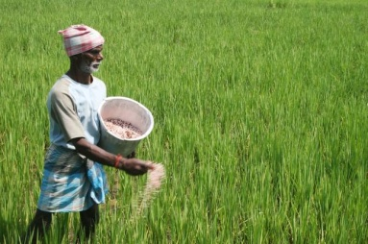
Evaluation
Individually:
Time : 10 minutes
What picture is it ? What`s occupation of this man?
(Tick marks √ )
a. A farmer b. A doctor
c. A teacher
√
a. A farmer b. A tailor
c. A teacher
√

Slide 13
Group work:
Write the name of two occupations:
A-group:
1.Teacher
2.Tailor
B-group
1.Doctor
2.Cobler
C-group
1.Farmer
2.Blacksmith

Slide 14

Home work
write another three occupations of your village:

Slide 15
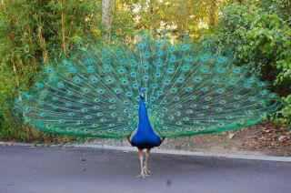
Good bye
See you again.

